Slide 1
ACMW Java Workshop
9/27/2019
Avery Peck, Chris Sherman, Gladys Toledo-Rodriguez, George Schaefer

Slide 2
Agenda
Java big picture concepts
JVM/JRE
JDK
Running Java
Java concepts
Methods
Classes
Arrays
File I/O
Inheritance/polymorphism

Slide 3
What is Java?
Java is a programming language and computing platform
Two aspects are related: if you write a program in the Java programming language, you need to be able to run it on a computer -- ideally every computer
JVM or Java Virtual Machine is a specification of a computing platform that can run Java code. It acts like a mini computer that uses the resources of your computer. Every computer has its own implementation of a JVM

Slide 4
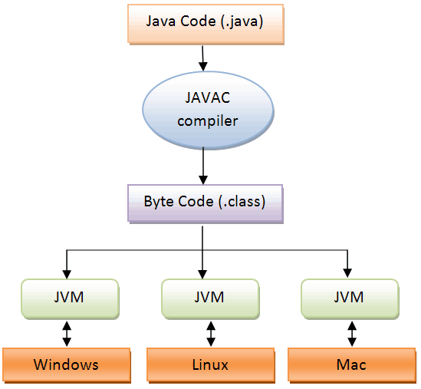

Slide 5
What is Java?
All Java classes, when compiled, turn into Java bytecode, which is low-level assembly instructions for the Java Virtual Machine to execute.
So the JVM (usually you download it packaged with some basic java classes and support structures as the JRE or Java Runtime Environment) is what you need to run Java programs
The JDK, or Java Development Kit, is what you need if you want to write Java programs.
The JDK contains the compiler, which turns Java into bytecode .class files.

Slide 6
Which one do I need?
“Usually, if you only care about running Java programs on computer you will only install the JRE. It's all you need. On the other hand, if you are planning to do some Java programming, you need to install the JDK instead” -helpful StackOverflow user

Slide 7
So you wanna write some Java code...
The basic steps for creating and running a Java program are:
Edit the code
Save the code
Compile the code
Run the .class file
And you can do this with Eclipse, it’s just clearer and simpler on the command line
Link on the Github to “How to Install the JDK”

Slide 8
Break to install Java
Notes:
Try to be done with this by 11:30

Slide 9
Developing in Java
Create a file in a basic text editor, like TextEdit on mac, or Notepad in windows

Slide 10
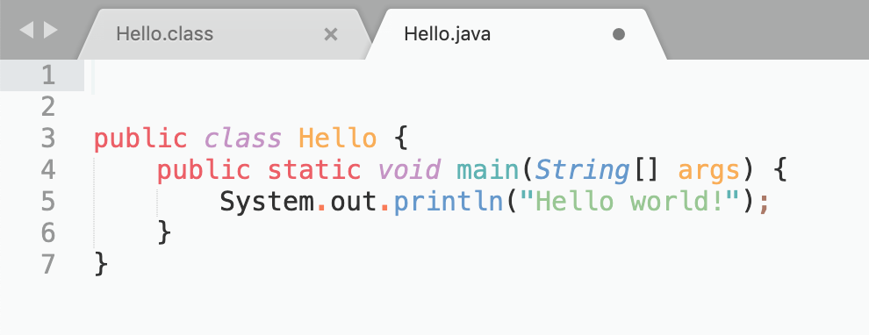

Slide 11
Developing in Java
Create a file in a basic text editor, like TextEdit on mac, or Notepad in windows
Save it with some <Name>.java
Note: the name should be upper-case!

Slide 12
Developing in Java
Create a file in a basic text editor, like TextEdit on mac, or Notepad in windows
Save it with some <Name>.java
Note: the name should be upper-case!
Open your terminal application (Called “Command Prompt” on Windows) and navigate to the folder containing the file you just created
Type in “javac <Name>.java” and hit enter
Type in “java <Name> and hit enter

Slide 13
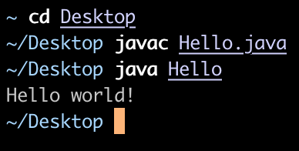

Slide 14
Developing in Java
Edit .java file
Save .java file
Compile .java file
Run .class file

Slide 15
Exercise
Now that you have Java on the command line, go to the Github repo for this workshop at https://github.com/apeckstl/JavaWorkshopFall19
Try to compile and run the basic HelloWorld.java file in the Basics folder
Remember: make sure you are inside the folder in your terminal
Type javac HelloWorld.java and hit enter
Type java HelloWorld and hit enter
Notes:
Try to be done by 11:45

Slide 16
User defined methods

Slide 17
Defining your own method
So we know that whatever code is inside the main method will run when we run our program
But what if we have a very long complicated program that we want to split up into different sections that do different things?
This is where methods come in

Slide 18
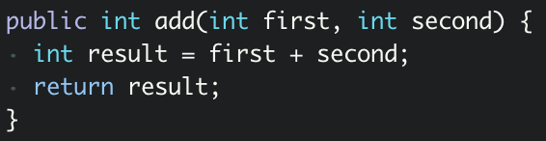
Anatomy of a method
The return type
The name of the method
The parameter types and their local names
The return value (must be the same type as the return type above

Slide 19
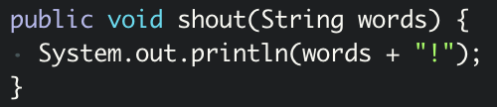
Anatomy of another method
The return type
The name of the method
The parameter type and its local name
No return value

Slide 20
Static
If you try to add the method we just wrote into a class and call it from the main method, you will get this error: “non-static method cannot be referenced from a static context”
WHAT DOES THIS MEAN??
When you write the code for a class, every method is non-static unless stated otherwise
That means in order for a method to work, there has to be an object of the class out there in the world
The main method is always declared static because it is a fundamental property of a class...it exists whether the class has been instantiated or not

Slide 21
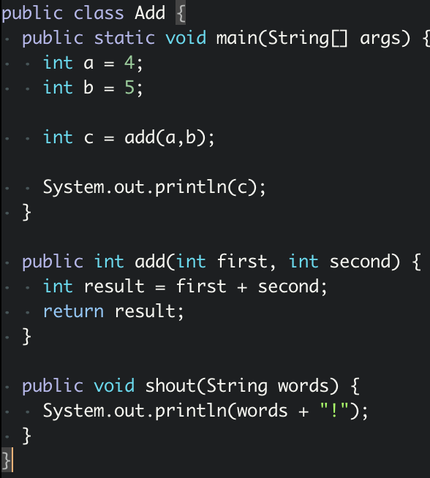
Static
But our add method is written to be a property of a specific object:
This code won’t run because add can’t be called unless it’s on a specific Add object. The main method is a property of the class, but add is a method for an object of the class.

Slide 22
A Static Method is...
It is a method which belongs to the class and not to the object (instance)
A static method can access only static data. It can not access non-static data (instance variables)
A static method can call only other static methods and can not call a non-static method from it.
A static method can be accessed directly by the class name and doesn’t need any object
A static method cannot refer to "this" or "super" keywords in anyway

Slide 23
So how to fix the error?
There are two solutions: one is to make our add method a static method (you can see that in the finished code on Github). This means that we can call it from the main method
The other solution is to put our method inside a different class, then make a new object of that class and call the method there
Confused yet?
Next section: classes

Slide 24
Exercise
Level 1:
Create a program called Echo.java with an empty main method. Create a function called repeat that has the return type String and takes in a String parameter. It should turn the string it receives as a parameter and double it, then return that. (So if I called repeat(“Hey!”) it would return “Hey! Hey!”. Then try to call it in the main method.
Level 2:
Write a Java method to find the smallest number among three numbers that it receives as parameters
Notes:
Done by 12:00

Slide 25
Defining your own classes

Slide 26
Instance vs. Class Variables
Instance Variables are variables allocated in the memory for each object (or instance of the class) that is made using that class
Each object gets its own instance variables
These are only declared first; they aren’t assigned values until the constructor
When making instance variables, think about what data each object needs to represent the abstracted real world thing or concept
Class Variables transcend individual objects and belong to the class itself
No object gets its own variable
Initialized to a value almost always without calling a method or a constructor
Instead, the variable belongs to the class, and all objects can use it but its data is separate from the objects
Created using the “static” keyword

Slide 27
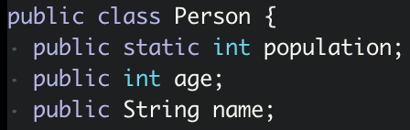
Instance vs. Class Variables
The population variable belongs to all Person instances and even exists without any Person objects being created. The age and name variables will be unique to every instance of Person

Slide 28
User-Defined Classes
Used to create a template data type
Meaning a data type built off other data types to represent a real world thing, like Ice Cream or a Shopper
Then, you can use that data type in a client program (the one with the main method)
Common Parts to a User-Defined Class
Attributes
Constructor
Setters
Getters
Extra Methods
Helper Methods

Slide 29
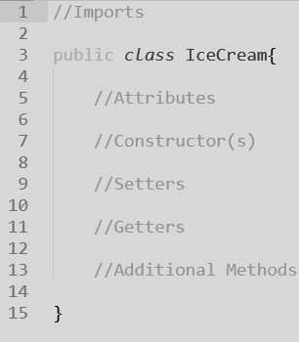
User-Defined Classes
With these parts in mind, I recommend starting to write your class like you can see to the right
This will remind you the steps you need to take to write your class
It is also an effective way to apply pseudocode to your class!

Slide 30
Attributes
Remember:
An object is a bunch of data hidden behind the scenes and methods to operate on that data
A class is a blueprint for making an object
That “bunch of data” is called the group of attributes for that class
A.k.a. Instance variables
Attributes are variables that describe the characteristics of whatever the object represents
When defining attributes for a class
For your purposes they have private access
They are only declared - do not assign them until the constructor!
I will be using a Chair class for the rest of my examples

Slide 31

Attributes
Each attribute (instance variable) is private - cannot be accessed outside of this file
Each attribute has a type (as all variables need in Java)
Each attribute has an identifier (as all variables need in pretty much any language
NONE of these are assigned values yet, until...

Slide 32
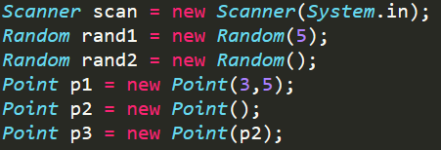
Constructors
You’ve used them for other objects a lot by now… time to make your own!
Remember how you didn’t assign value to the attributes (instance variables)?
It’s the constructor’s job!
The constructor will assign values to the instance variables and do any other actions required for the beginning of an object
You can declare parameters to take additional information, or you can not
Gives information that affects how the constructor does its job
These are different types of constructors - the client determines which one to run
You can have multiple constructors
If they take different parameters, Java sees them as different entities and allows both to exist

Slide 33
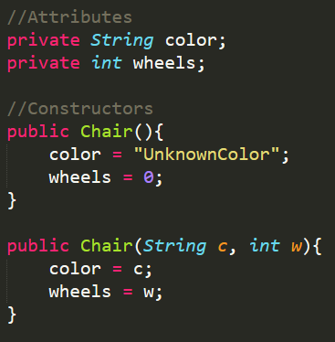
Constructors
Constructors are always public (unlike attributes)
Always match the constructor name with the name of the class (see examples on last slide, too)
See how the attributes can be used because they are defined above
See how the parameters can be used as if already initialized

Slide 34
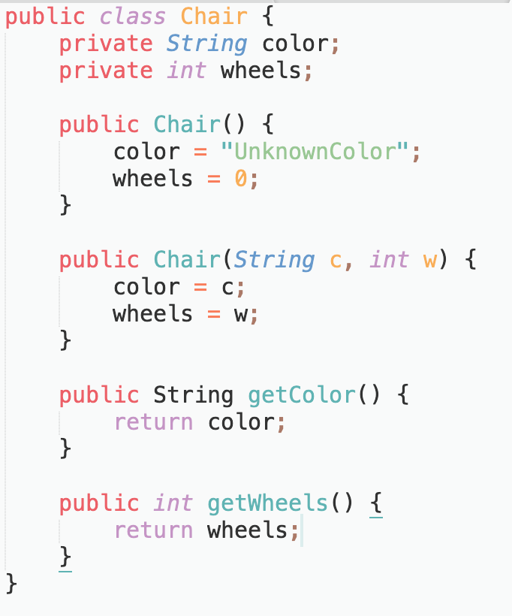
Constructors
See the two different constructors that can be used
You now have 2 ways of creating a Chair object, depending on how much you know about the chair at the time
We put in two basic getters to access the variables

Slide 35
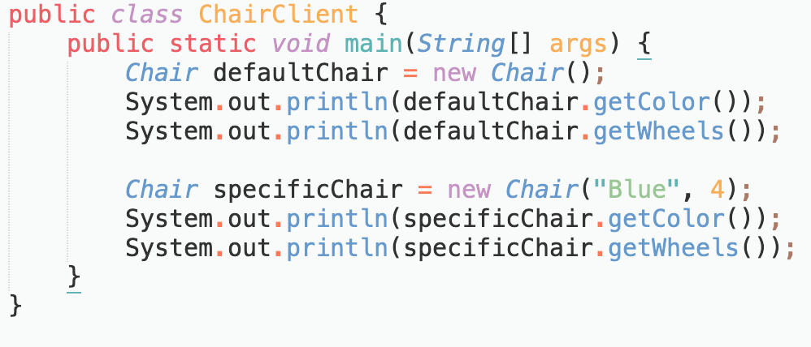
Constructors - Client class
Here is an example of using both constructors, one gives the default values, the other lets you set the values when you create the Chair
Take a few minutes and work on your laptop to create this Client class. Make sure that your two .java files are in the same folder!

Slide 36
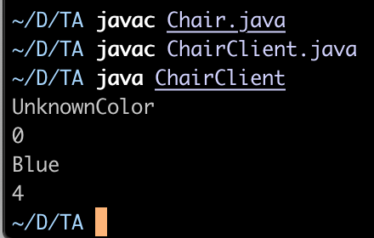
Notes:
Allow individual work on this concept

Slide 37
Exercise
Level 1:
Modify the Chair.java file to give the Chair class some more instance variables. Maybe a “type” attribute, or a “manufacturer” attribute. Change the constructors once you have the variables
Level 2:
Add a static class variable “numberOfChairs” that the Chair constructors increment by 1. Then in the client class, print out the numberOfChairs variable once you’ve created a few chairs
Notes:
Done by 12:30

Slide 38
Arrays

Slide 39
Arrays
Set size lists of things - all the same type
So you can have an int array, or String array, or Chair array
The variables in the array are ordered and each have an index beginning from 0
Declare an array variable using type varName[]; OR type[] varName;
For example: int [] intArray;
But this is only the declaration - it establishes the fact that intArray is an array variable, no array actually exists
The compiler now knows that the variable will hold an array of ints

Slide 40
Arrays
Now we have to actually create the array
To actually create or give memory to array, you create an array like this:
varName = new type [size];
To use new to allocate an array, you must specify the type and number of elements to allocate
There is a special case, if you know the elements of the array already:
int[] intArray = new int[] { 1,2,3,4,5,6,7,8,9,10 };

Slide 41
Arrays
Now how do we access and set the elements in the array?
We use an index which is a number that refers to the position of the element
We index into an array (or get the element at an index) intArray[3]
This will return the 4th element of intArray
The type of intArray[3] will be whatever the type of the array is

Slide 42
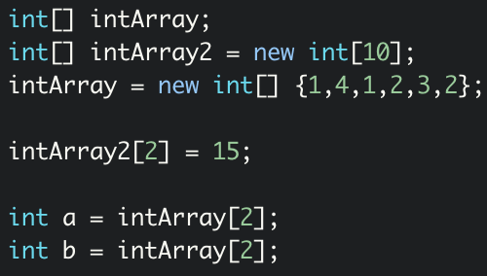
Correct declaration
Declare an int array
Declare and instantiate a different array
Instantiate the first array with some values
Set the value of one element in the array to 15
Assign the value of the 3rd element of the array to an int variable
Assign the value of the 3rd element of the second array to an int variable

Slide 43
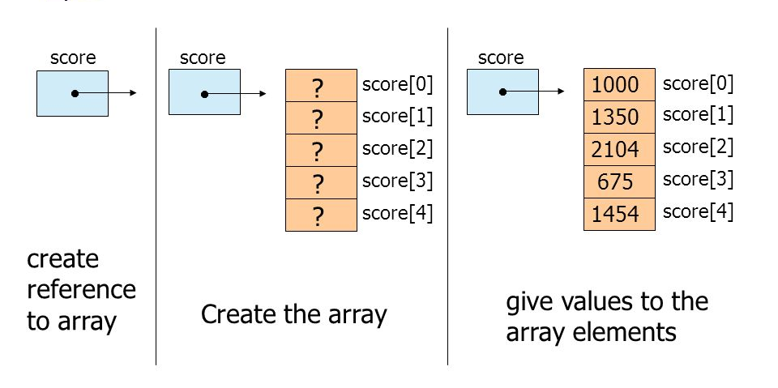
Declare the array variable
Instantiate the “slots” of the array
Set the values of the elements

Slide 44
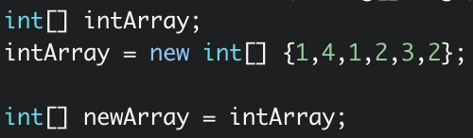
Duplicating arrays
Array variables are just references to somewhere in memory where the actual array is stored
Think of the variable as an arrow that points to the memory
This means that when you do this:
Both intArray and newArray are pointing to the same array in memory

Slide 45
Duplicating arrays
This means that if you change intArray[3], newArray[3] will also change
So if you really want to copy, you need to create the newArray variable, then instantiate it with its own slots before copying the data element-by-element
Example code in the Github

Slide 46
Exercise
Level 1:
Write a Java program that takes an array of strings and prints each string that begins with “a”
Level 2:
Read the .txt provided in the github that just contains a long list of numbers and put the numbers into an int array. Find the average of the numbers
Notes:
Done by 12:45

Slide 47
File I/O

Slide 48
File I/O
In Java, most file reading and writing is handled by a set of classes in Java’s io package
The basic idea is input source -> program -> output destination
The io package treats all input and output files as “streams”
The first class we will look at is Java’s FileInputStream and FileOutputStream
These classes provide methods that read 1 byte (8 bits) or write 1 byte at a time
It is up to you as programmer to repeat as many times as needed

Slide 49
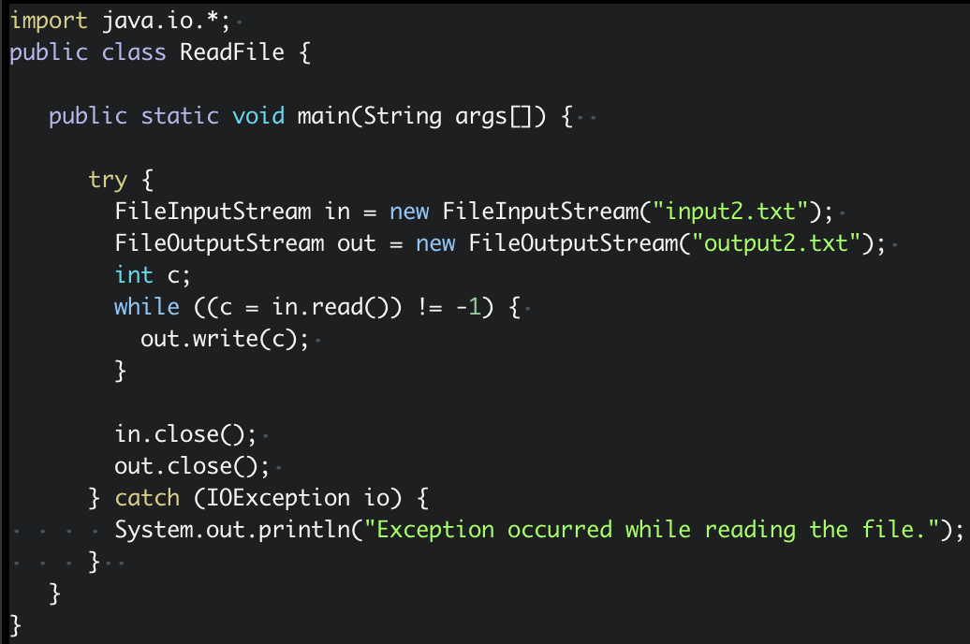
Example program

Slide 50
What is happening here?
int c;
while ((c = in.read()) != -1) {
out.write(c);
}
The FileInputStream class consumes 1 byte at a time from the data streaming into it from the input file
c = in.read() puts 1 byte of the input into an int. If there is no byte to read, the value of c will be -1
out.write() writes that 1 byte to the output stream

Slide 51
Example program

Slide 52
Things to remember
Must import the java.io.* package!
To import only the classes you need, you would write “import java.io.FileInputStream” and “import java.io.FileOutputStream”
Remember to continue to read bytes from the input until there are none left
You should call .close() on your FileInputStream and FileOutputStream objects when you are done
Reading from a file always has the potential to throw errors...catch your exceptions!!!

Slide 53
Example program

Slide 54
Other types of reading files
Using FileInputStream and FileOutputStream is limited because it only reads a byte at a time
How many different characters can you represent with 1 byte?

Slide 55
Other types of reading files
Using FileInputStream and FileOutputStream is limited because it only reads a byte at a time
How many different characters can you represent with 1 byte?
ASCII characters are the basic set of characters that can be represented with a byte
That excludes characters from other languages, symbols, and even emoji

Slide 56


Slide 57
Other types of reading files
In order to read and write Unicode characters, you can use Java’s FileReader and FileWriter classes
They work almost identically to FileInputStream and FileOutputStream, except they read 2 bytes at a time, instead of 1

Slide 58
Using a Scanner with a file
You’ve probably used the Java Scanner class before to read user input
The same Scanner class can be used to read input from a File object
This lets you use cool methods like .hasNextLine(), .readNextInt(), .readNextLine()

Slide 59
Use a Scanner on a file
import java.util.Scanner;
public class ScanFile {
public static void main(String args[]) {
try {
Scanner sc = new Scanner(new File("input.txt")); // Set up
while (sc.hasNext()) { // loop and read
String str = sc.nextLine();
System.out.println(str);
}
sc.close(); // Clean up after yourself
} catch (IOException io) {
System.out.println("Exception occurred while reading the file.");
}
}
}

Slide 60
Exercise
Level 1:
Write a program to read each country name in the input file, and write the first letter of each name to an output file. Find the input file in the Exercises folder on Github, called “Exercise1.txt”
Level 2:
Write a program that will count the number of lines in each file that is specified on the command line. Assume that the files are text files. Note that multiple files can be specified, as in "java LineCounts file1.txt file2.txt file3.txt". Write each file name, along with the number of lines in that file, to standard output. If an error occurs while trying to read from one of the files, you should print an error message for that file, but you should still process all the remaining files.
Notes:
Done by 1

Slide 61
Inheritance and Polymorphism

Slide 62
Polymorphism
“Having many forms”
There are two forms of polymorphism, Overloading and Overriding.
Overloading is compile time polymorphism. When your program is compiled java decides which version of a method is being invoked. You’ve actually already used this by creating default and overloaded (non-default) constructors.
Overriding is runtime polymorphism. It is used alongside inheritance to distinguish between different forms of the same method when your program runs.

Slide 63
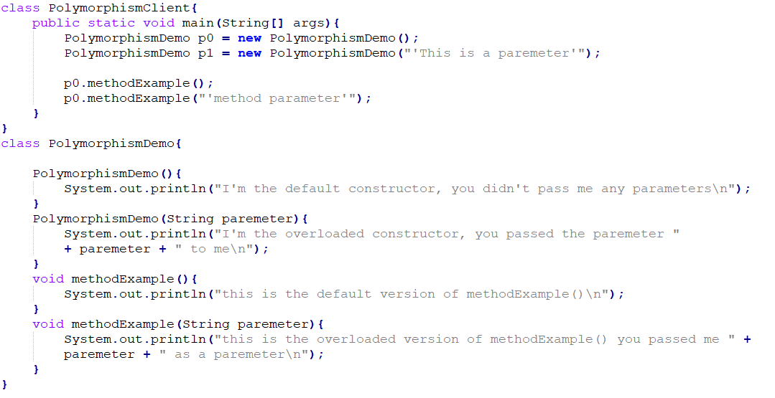
Compile Time Polymorphism Demo

Slide 64
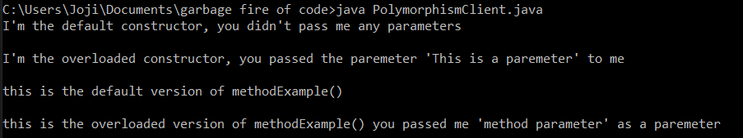
Compile Time Polymorphism Demo; the Output

Slide 65
Runtime Polymorphism
So what is this second form of polymorphism?
Let’s put a pin in that for now, I don’t want to make two examples it’s easier to understand if we talk about inheritance first.

Slide 66
Inheritance - What is it?
Programming is about being lazy, we don’t write something twice if we only have to write it once.
Super classes, also called parent classes, let us share features of different objects. If two classes have something in common, we make super classes to let them share things like methods and variables.
Abstract classes act like a template for classes that inherit them. We specify the features a subclass must fulfill.
Sub classes, also called child classes, allow for differences between objects. e.g. Chairs and shelves are both furniture, but they aren’t the same kind of furniture.

Slide 67
Inheritance - Why use it?
Let’s say we want to make objects that represent pieces of furniture. There are many different kinds of furniture. What do they all have in common? What might be specific to a couch, or a shelf?
All furniture objects have:
Names
Colors
Couches have:
A maximum occupancy
Shelves have:
Storage volume
A number of partitions

Slide 68
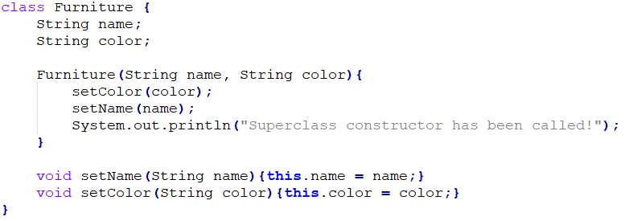
Inheritance - Super Classes

Slide 69
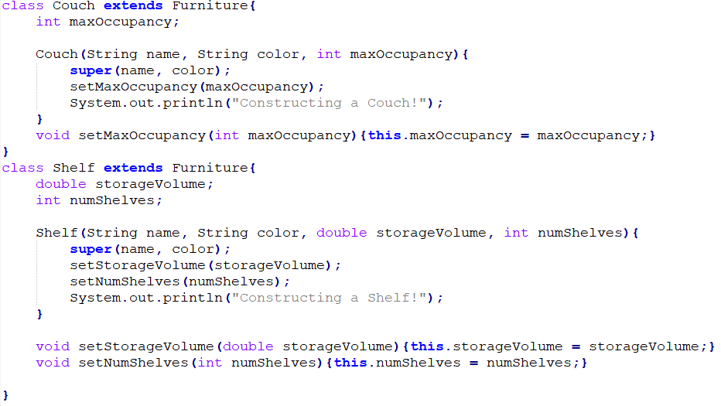
Inheritance - Subclasses
Extends tells java that these classes inherit the Furniture class
Super sends parameters to the super class

Slide 70
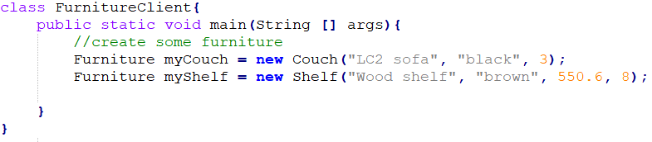
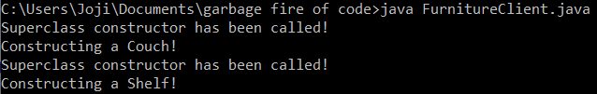
Inheritance - Creating Objects

Slide 71
Inheritance - Abstract Classes and Methods
‘Furniture’ isn’t really a tangible thing, it’s more of an abstract idea. So why is our Furniture class a thing?
Let’s change that by making it an Abstract class, a class that cannot be instantiated. We use them to define things for classes that inherit them.
In much the same way, Abstract Methods force subclasses to implement their own version of a certain method.

Slide 72
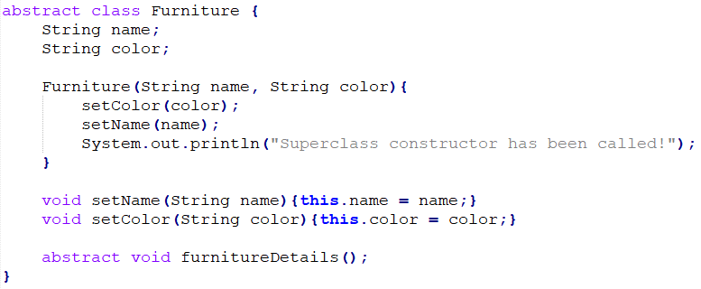
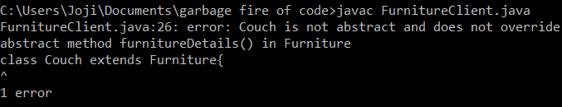
Inheritance - Abstract Class and Method
The abstract keyword tells java the class or method we define is abstract
Notice how the abstract method doesn’t have a body? It’s the subclass’s job to implement that.
If the subclass does not implement it, we get a compilation error.

Slide 73
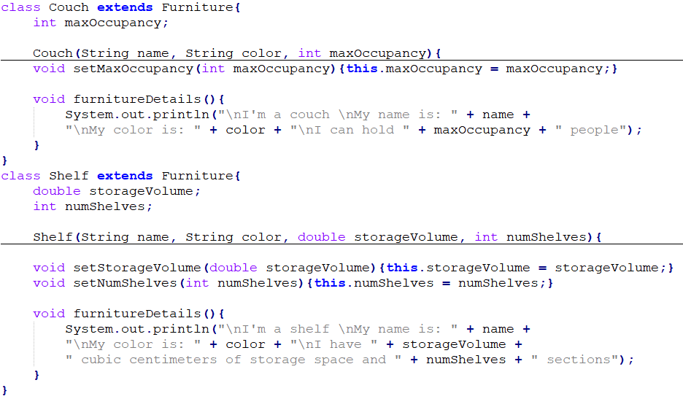
Inheritance - Implementing an Abstract Method

Slide 74
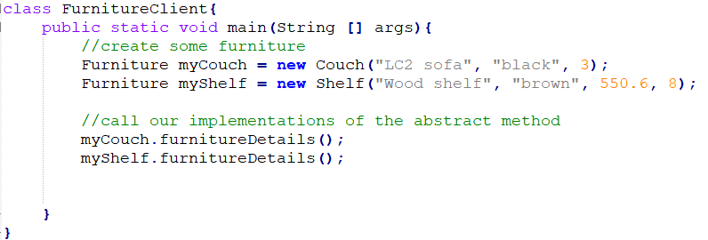
Inheritance - Calling Abstract Methods
It’s just like calling a normal method!

Slide 75
No, I Didn’t Forget to Explain Runtime Polymorphism
It’s not just like calling a normal method!

Slide 76
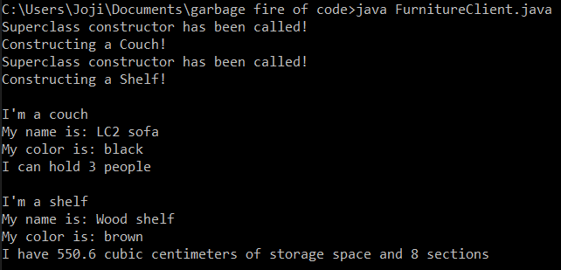
Inheritance - Calling Abstract Methods; the Output

Slide 77
Polymorphism and Inheritance Summary
Two kinds of polymorphism, Overloading and Overriding
Inheritance lets us reuse code for similar objects
We use the extends keyword in subclasses to tell java that 1) this is a subclass, and 2) what the superclass it inherits is
super() sends parameters from the subclass constructor to the superclass constructor
The abstract keyword makes a class or method is abstract. We can’t use them directly, they put restrictions on subclasses.

